Slide 1
Interactions in Altair
SI 649 / EECS 548
Yelnaz Rysbek
Adapted from Vega-Altair Documentation and Dallas Card

Slide 2
Plan for today
Part 1: Demo of Altair Interactions
Bonus: Exporting Interactive Charts
Part 2:
Recreate Gapminder and create your own visualization
Part 3:
Sharing progress with peers and discussion of assignment part 2

Slide 3
RE: When to use Altair specific transformations?
Building compound charts with shared data sources but different views of data (example in the next slide)
Creating interactive visualizations where transformations respond to user selections (we will look at an example in the next workshop).
We will see examples of transform_filter(), transform_aggregate() and transform_calculate() in our interactive charts

Slide 4
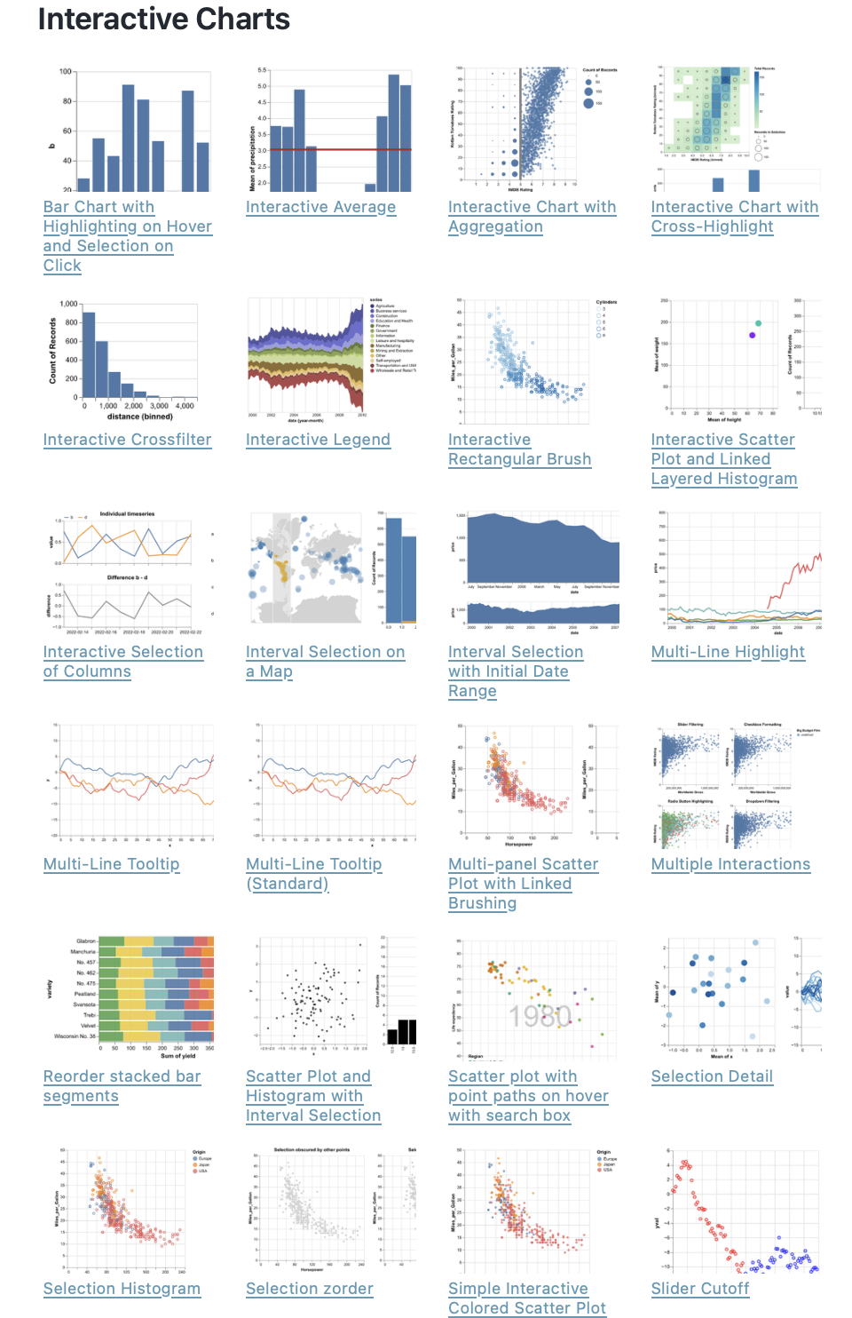
Interactions in Altair
Explore interaction techniques in documentation and interactive charts gallery

Slide 5
General pattern
Selector
Condition
Add to Chart
Encode

Slide 6
Pattern explained
Selector – Define what the user can interact with, two types:
alt.selection_point() / alt.selection_interval() – responds to direct interaction with the chart (drag, click)
alt.param() – holds a value bound to an external UI control (slider, dropdown)
Condition – Define what happens based on the parameter's value
alt.when(selection).then(if_true).otherwise(if_false)
e.g., highlight selected points, grey out the rest
add_params() – Register the parameter with the chart so it actively listens for user input
Without this, the parameter exists but has no effect
The same parameter can be added to multiple layers for linked interactions
Encode – Apply the condition inside .encode() to map it to a visual channel

Slide 7
Altair demonstration

Slide 8
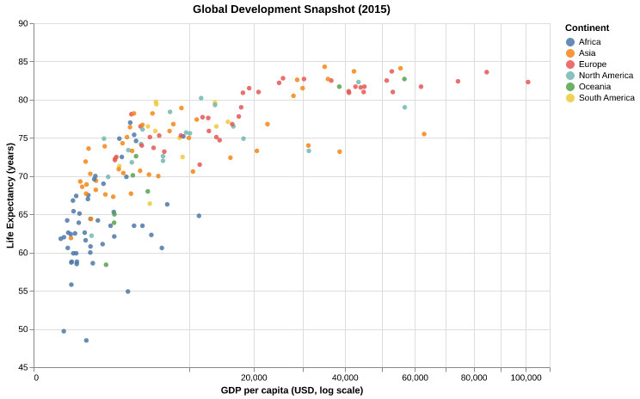
Lab 7 Assignment
Make a copy of this notebook
Take a look at the version Gapminder dataset
Using Altair, recreate the Gapminder 2015 snapshot
Create an animated version of the visualization that shows how the data changes across years
Come up with a new visualization using the same data that provides additional insight
Combine visualizations in one single .html file and submit to Canvas along with runnable Python notebook

